Slide 1
Fundamentals of Data Science Final Project Modeling of Disease and Protein Correlation based on Indexed MeSH terms
Preeti Gokal Kochar, PhD

Slide 2
Overview Slide
Exploratory analysis of PubMed/MEDLINE citations for Marfan, Loeys-Dietz, Ehlers-Danlos and Weill-Marchesani Syndromes using indexed Medical Subject Headings (MeSH)
Association between Marfan Syndrome and indexed proteins was investigated using several models
This method may be used to study other correlations using PubMed/MEDLINE and other NLM databases

Slide 3



Marfan and Marfan-like Syndromes https://www.marfan.org/about/marfan
Genetic disorder that affects the body’s connective tissue, connective tissue holds all the body’s cells, tissues and organs together
About 1 in 5,000 people have Marfan syndrome
Affects heart, blood vessels, bones, joints, eyes lungs, skin and nervous system, aortic enlargement – can be life-threatening

Slide 4
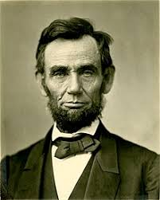
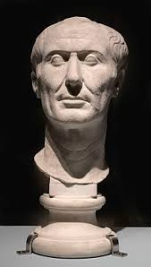

Famous people with Marfan Syndrome
https://www.wikipedia.org/
Abraham Lincoln
Julius Caesar
Michael Phelps

Slide 5
Data Source
Data obtained using Search (MeSH) for Marfan-like syndromes searchstring= Marfan Syndrome [MH] OR Loeys-Dietz Syndrome [MH] OR Ehlers-Danlos Syndrome [MH] OR Weill-Marchesani Syndrome [MH] Citations retrieved: 8848

Slide 6
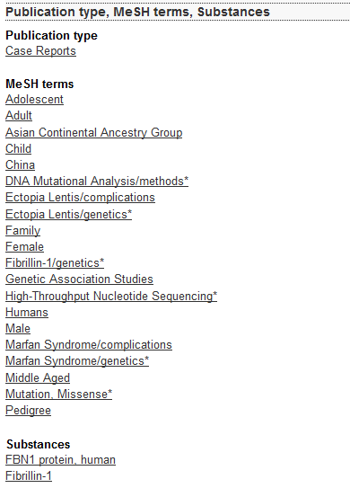
PubMed/MEDLINE Citation Example; PMID:30552983
Gene. 2019 Mar 20;689:51-55. doi: 10.1016/j.gene.2018.12.005. Epub 2018 Dec 12.
Identification of a novel mutation in FBN1 in a Chinese family with inherited ectopia lentis by targeted NGS. Danmin Cao et. al. Aier School of Ophthalmology…. Hubei Province 430063, China.
AIMS:
To diagnose a Chinese family with inherited ectopia lentis in a genetic method and analyze the genotype-phenotype correlation.
METHODS: The phenotype…
RESULTS: A novel mutation c. 385T>C (p.C129R) in FBN1 was identified…
CONCLUSIONS:
Our study reports a novel mutation in FBN1…
Data:
Protein terms and Syndrome terms in each citation

Slide 7
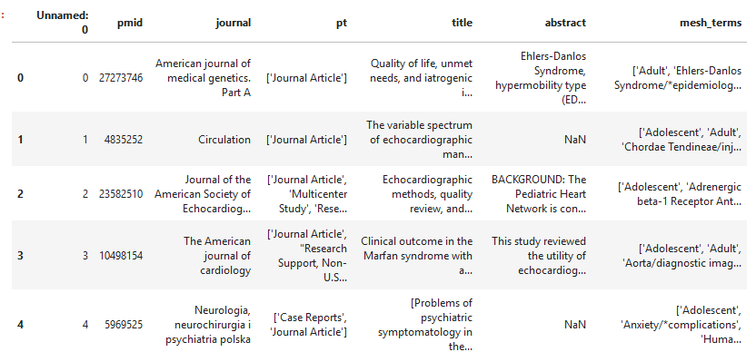
First 5 rows of imported Pandas Dataframe

Slide 8
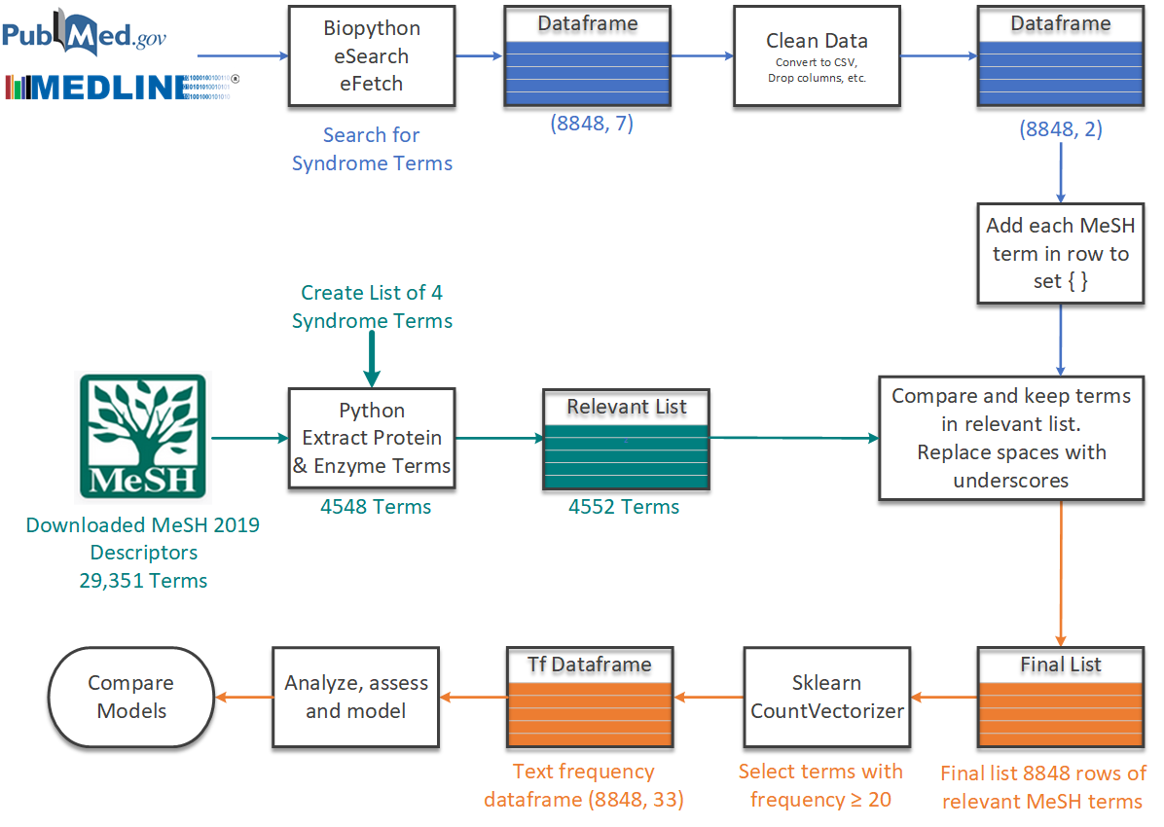
Importing, Extracting and Processing the Data

Slide 9
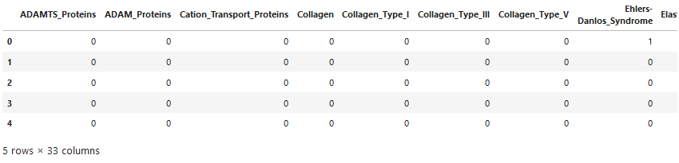

Cleaned, Transformed Data using CountVectorizer
CountVectorizer is a sklearn feature that converts a collection of text documents to a matrix of token counts. It produces a sparse matrix as shown below:
Top 33 most frequent terms are listed as column headings in the matrix (Dataframe):
Total number of occurrences of the top 33 terms across all the 8848 citations:

Slide 10
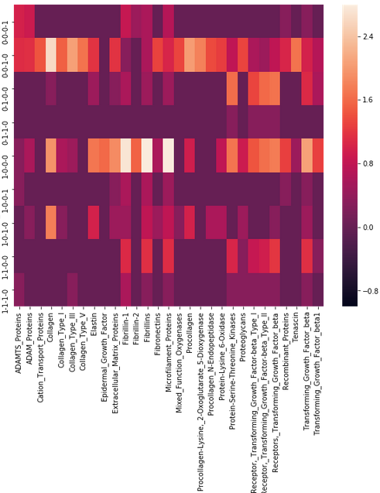
Heatmap: Syndromes vs Proteins
Heatmap uses a log intensity scale to better display the wide range of frequencies of proteins
Heatmap was used to inform model selection
MFS and Microfilament proteins, Fibrillins and Fibrillin-1 showed strong correlation, selected for modeling
WMS
EDS
LDS
LDS, EDS
MFS
MFS, WMS
MFS, EDS
MFS, LDS
MFS, LDS, EDS

Slide 11
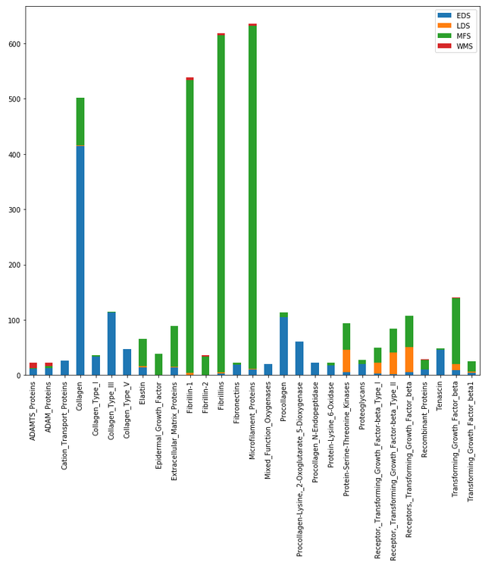
Bar Chart of Proteins associated with Syndromes
Frequency data was also displayed as a bar chart using a linear scale
Selected Microfilament Proteins as feature associated with Marfan Syndrome
Fibrillins
Microfilament_Proteins

Slide 12
Modeling
Based on heat map and bar plot, compared performance of several models to determine association of Marfan Syndrome using:
A single feature: Microfilament_Proteins
Five features: Microfilament_Proteins, Fibrillins, Fibrillin-1, Collagen and TGF_beta
In addition, the possibility of improving performance of the models using filtered data was investigated. Filtered data set contained at least one protein term in addition to the syndrome term.
All data: 8848 rows
Filtered data: 2145 rows

Slide 13
Results
All Data: All 8848 rows used for model
Filtered Data: 2145 rows used, with at least one protein term indexed
Model | Data | Accuracy Score One Feature | Accuracy Score Five Features
Naïve Bayes | All | - | 0.69
 | Filtered | - | 0.66
K Nearest Neighbor | All | - | 0.69
 | Filtered | 0.75 | 0.82
Linear Regression | All | - | -
 | Filtered | 0.75 | 0.75
Logistic Regression | All | - | -
 | Filtered | 0.75 | -
Items marked with a ‘-’ were either not run or did not yield interpretable results.
All Data: All 8848 rows used for model
Filtered Data: 2145 rows used, with at least one protein term indexed

Slide 14
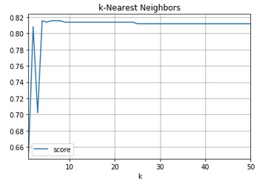
Conclusion
The best performing model was kNN, k=7 accuracy score = 0.82;
Five proteins were used to predict classification of Marfan Syndrome as distinct from the other listed syndromes
Filtered data used with 2145 rows
Target: Marfan Syndrome
Features: [Microfilament_Proteins', 'Fibrillins', 'Fibrillin-1', 'Collagen','TGF_b’]
Filtered Data used (at least one protein term in the row)

Slide 15
Acknowledgements
Data Science @NLM Team
Instruction team: Dan Wilhelm, Julian Oquendo and Chris Marker
Melanie Huston for help with BioPython
…and many more!

